Slide 1

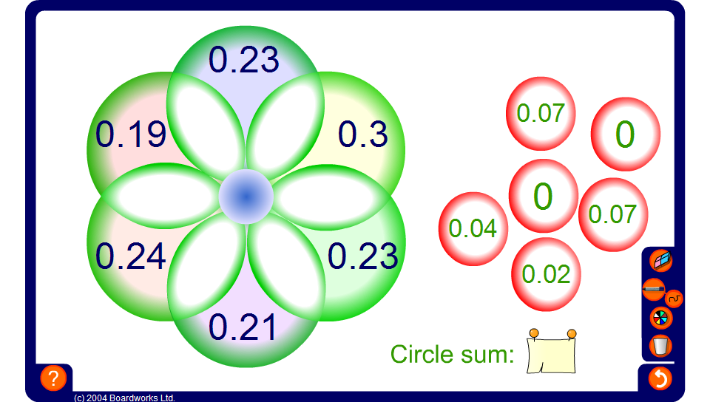


Circle sums – two decimal places
Notes:
The circle sum puzzle on this slide uses numbers written to two decimal places.

